Slide 1
Transitioning to NVMe/PCIe SSDs
2016 December 30

Slide 2
30 Second Presentation

Slide 3
Enterprise Server Storage Evolution
Data Center Managers can now select storage performance that:
Optimizes Workloads and Fits in Budget
Legacy Data Center SSDs
Use same SATA and SAS Technology Designed for HDDs
Performance Hindered by Inefficient Interfaces with Server
New Non-Volatile Memory Express (NVMe)
Designed to Optimize Solid-State Storage Technology
Capitalizes on the Low Latency and Parallelism of Solid-State
Notes:
The enterprise market for server storage has seen a revolution.
Traditional mechanical hard disk drives (HDDs) are giving way to faster solid-state storage technology in the data center. Data center managers now have the option to select the storage performance that optimizes both their workloads and budget.
Solid-state storage technology has also evolved since its introduction. The first SSDs were designed to use the same technology used by existing HDDs to provide servers with immediate storage compatibility with existing servers. This older technology used SATA and SAS bus interfaces and SCSI and AHCI logical device interfaces. Each of these were designed to address the needs of traditional mechanical disk drives – at times purposely adding latency to ‘wait’ for the mechanical operations of the drive to complete – making them inefficient for the newest SSD storage solutions.
In order to address the needs of solid-state technology, the industry developed the Non-Volatile Memory Express (NVMe) standard. This standard was designed from the ground up to capitalize on the low latency and internal parallelism of solid-state storage devices.
The adoption PCIe/NVMe host bus, logical device interface combination to attach SSDs, allow data center server’s entire storage subsystem to reach its highest performance.

Slide 4
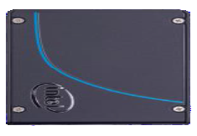
Advantages of NVMe/PCIe over SAS for SSDs
Provides Best Bandwidth & Lowest Latency for SSDs
Second Only to DRAM in Performance & Latency
Designed and Optimized for SSDs Replacing Interface Designed for HDDs
Directly interfaces with Intel CPU Maximizing Performance
Less Power - Typically > 2W Idle and >9W Maximum
Eliminates HBA Overhead and Cost
Scalable Performance, Flexible Form Factors, and Industry Standard Stability
Notes:
NVMe/PCIe offers the best storage bandwidth and lowest latency for SSD storage, in part because the PCIe connection offers direct lanes to the server’s Intel CPU that allows for advanced data coordination.
In addition, since the NVMe protocol provides a number of additional advantages over SAS and SATA for SSDs

Slide 5
Where PCIe/NVMe Storage Should be Recommended
Where Increased Responsiveness and Performance outweigh the Price Premium of PCIe/NVMe Storage
Ideal for any Data-heavy, Low-latency Content
Where Data is Local & Dedicated to the Server
Applications such as OLAP, OLTP, and Video
Not Recommended as a Boot Drive
Lower cost SATA SSDs are Adequate/Less Expensive
Notes:
PCIe/NVMe storage is the fastest, lowest latency access to data available to servers. Connecting storage using the PCIe bus and NVMe protocol eliminates the need for latency-adding adapters to attach storage.
This makes it ideal for any data-heavy, low-latency content when the increased responsiveness and performance can justify the premium PCIe/NVMe storage commands.
Applications that are data-heavy and benefit from low-latency include Online Transaction Processing (OLTP) and Online Analytical Processing (OLAP) applications.
In addition, customers looking to invest in in-memory solutions such as SAP HANA or IBM’s DB2 in memory database should also carefully evaluate PCIe/NVMe storage. A solution based on PCIe/NVMe storage may offer the performance boost needed, at a lower cost.

Slide 6
NVMe/PCIe is the Fastest, Lowest Latency SSD Server Storage
Developed Specifically for SSD Storage
High Performance, Low Latency SSD Storage
When Compared to SATA and SAS
NVMe is More than 2x as Efficient
NVMe Uses about 50% less CPU Resources
Notes:
Enterprise storage has undergone a dramatic performance boost with SSD storage. SAS and SATA SSDs use old technology designed for spinning hard drives to connect to the server.
The NVMe industry standard, developed specifically for SSD storage, eliminates the inefficiencies of older technology and the PCIe bus interfaces directly with the CPU. This makes PCIe/NVMe SSD storage the fastest SSD storage possible for a server.
NVMe over fabrics and the emergence of Intel Optane 3D Xpoint memory will ensure the continued evolution of SSD storage in the data center, however PCIe/NVMe attached SSD storage will remain the best performing, lowest latency connection for SSD server storage. This makes adoption of PCIe/NVMe storage in the data center a great investment.

Slide 7
3 Minute Presentation

Slide 8
Enterprise Server Storage Evolution
Data Center Managers can now select storage performance that:
Optimizes Workloads and Fits in Budget
Legacy Data Center SSDs
Use same SATA and SAS Technology Designed for HDDs
Performance Hindered by Inefficient Interfaces with Server
New Non-Volatile Memory Express (NVMe)
Designed to Optimize Solid-State Storage Technology
Capitalizes on the Low Latency and Parallelism of Solid-State
Notes:
The enterprise market for server storage has seen a revolution.
Traditional mechanical hard disk drives (HDDs) are giving way to faster solid-state storage technology in the data center. Data center managers now have the option to select the storage performance that optimizes both their workloads and budget.
Solid-state storage technology has also evolved since its introduction. The first SSDs were designed to use the same technology used by existing HDDs to provide servers with immediate storage compatibility with existing servers. This older technology used SATA and SAS bus interfaces and SCSI and AHCI logical device interfaces. Each of these were designed to address the needs of traditional mechanical disk drives – at times purposely adding latency to ‘wait’ for the mechanical operations of the drive to complete – making them inefficient for the newest SSD storage solutions.
In order to address the needs of solid-state technology, the industry developed the Non-Volatile Memory Express (NVMe) standard. This standard was designed from the ground up to capitalize on the low latency and internal parallelism of solid-state storage devices.
The adoption PCIe/NVMe host bus, logical device interface combination to attach SSDs, allow data center server’s entire storage subsystem to reach its highest performance.

Slide 9
Advantages of NVMe/PCIe over SAS for SSDs
Provides Best Bandwidth & Lowest Latency for SSDs
Second Only to DRAM in Performance & Latency
Designed and Optimized for SSDs Replacing Interface Designed for HDDs
Directly interfaces with Intel CPU Maximizing Performance
Less Power - Typically > 2W Idle and >9W Maximum
Eliminates HBA Overhead and Cost
Scalable Performance, Flexible Form Factors, and Industry Standard Stability
Notes:
NVMe/PCIe offers the best storage bandwidth and lowest latency for SSD storage, in part because the PCIe connection offers direct lanes to the server’s Intel CPU that allows for advanced data coordination.
In addition, since the NVMe protocol provides a number of additional advantages over SAS and SATA for SSDs

Slide 10
Storage Host Bus Comparison
Type | Speed | Disk Drive Attach | Data Paths | Type
PCIe | ~3.94 GBps | Internal | Four lanes/data paths | Gen 3
SAS | ~1.50 GBps | Internal & External | Two data paths | 12 GBps
SATA | ~0.50 GBps | Internal | Single lane/data path | 6 GBps
Notes:
A server uses a combination of host buses to communicate with both internal and external storage. Historically, most storage and SSDs used buses such as SATA, SAS, or Fibre Channel for interfacing with the rest of a computer system. In the data center, the SAS interface is a widespread, relatively fast and reliable. However, SAS and the included SCSI protocol logical interface layer are designed for spinning disk, not flash making them relatively inefficient when compared to the PCIe/NVMe interface.

Slide 11
NVMe/PCIe More than 2x as Efficient than SATA and SAS
Notes:
NVMe has streamlined and simplified the command set.
This provides two major benefits.
The First benefit, show in this chart, is that NVMe provides higher IOPS per instruction cycle and lower I/O latency in the host software stack.
In the chart, Relative Efficiency is determined by the interface that provides the most IPOS per CPU core. NVMe on PCIe leads the pack by providing 2.13 Relative IOPS/Core – more than 2x of those provided by ether their SATA or SAS counterparts.

Slide 12
NVMe/PCIe uses about 50% less CPU Resources
Notes:
The second major benefit is that NVMe/PCIe uses less than half the number of CPU instructions to process an I/O request when compared to SAS or SATA.
Since the NVMe protocol supports multiple deep processing queues, (an advancement over traditional SAS and SATA protocols ), which are designed such that I/O commands and responses operate on the same processor core and take advantage of the parallel processing capabilities of multi-core technologies.
In this chart, CPU Clock Cycles per I/O is shown. NVMe on PCIe uses less CPU resources by about 50% when compared to SAS and SATA.

Slide 13
Where PCIe/NVMe Storage Should be Recommended
Where Increased Responsiveness and Performance outweigh the Price Premium of PCIe/NVMe Storage
Ideal for any Data-heavy, Low-latency Content
Where Data is Local & Dedicated to the Server
Applications such as OLAP, OLTP, and Video
Not Recommended as a Boot Drive
Lower cost SATA SSDs are Adequate/Less Expensive
Notes:
PCIe/NVMe storage is the fastest, lowest latency access to data available to servers. Connecting storage using the PCIe bus and NVMe protocol eliminates the need for latency-adding adapters to attach storage.
This makes it ideal for any data-heavy, low-latency content when the increased responsiveness and performance can justify the premium PCIe/NVMe storage commands.
Applications that are data-heavy and benefit from low-latency include Online Transaction Processing (OLTP) and Online Analytical Processing (OLAP) applications.
In addition, customers looking to invest in in-memory solutions such as SAP HANA or IBM’s DB2 in memory database should also carefully evaluate PCIe/NVMe storage. A solution based on PCIe/NVMe storage may offer the performance boost needed, at a lower cost.

Slide 14
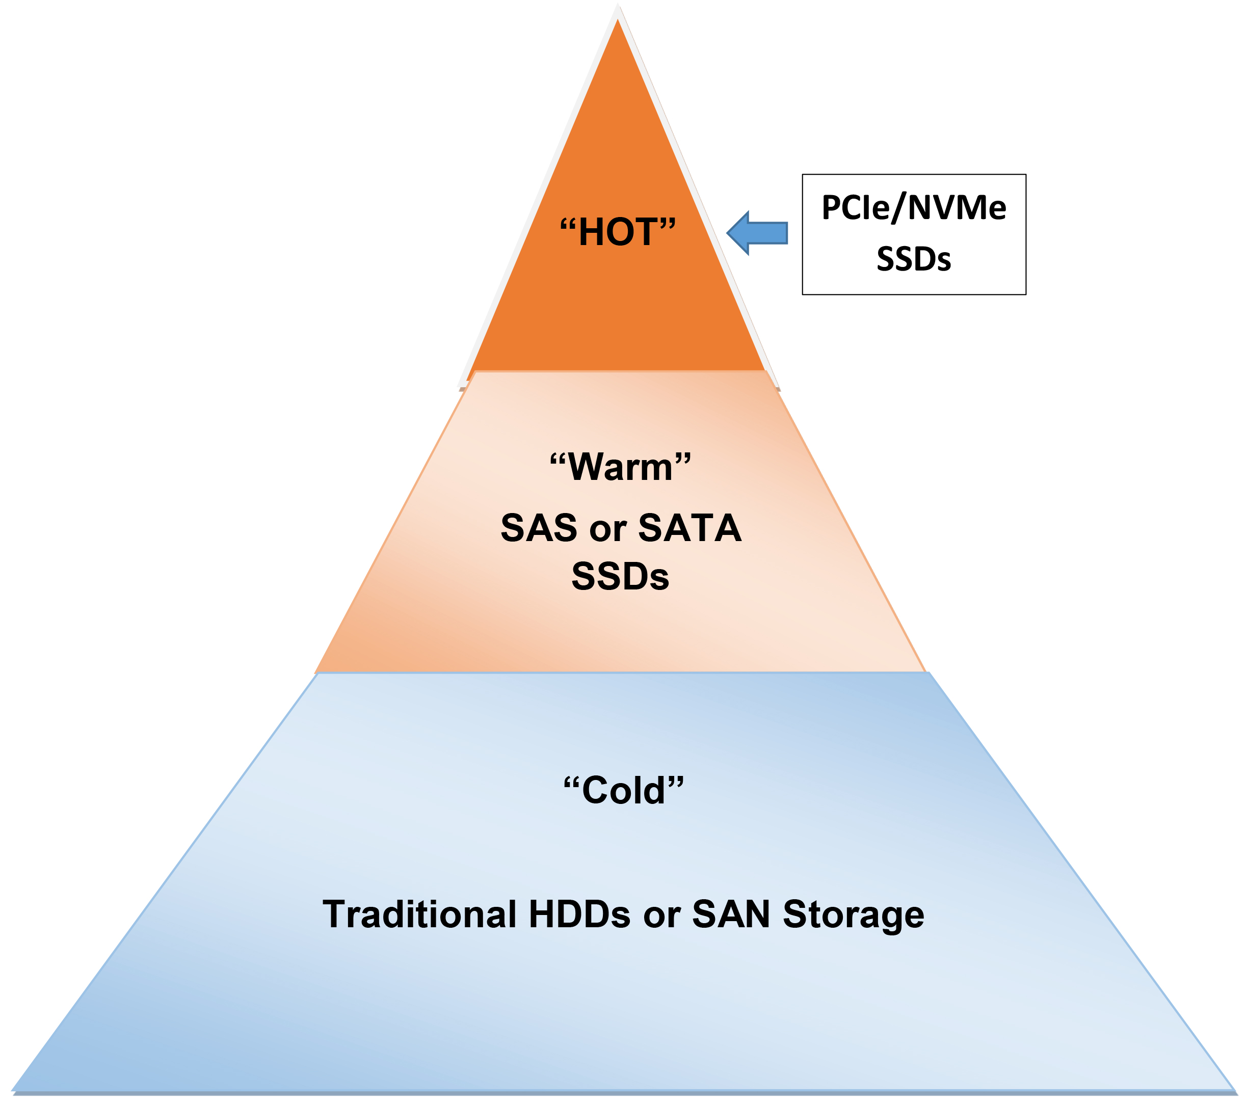
Perfect Fit - PCIe/NVMe SSDs as Cache or Tiered Storage
Caching - Active Data Copy Between Application and Storage
Provides Fast Storage Buffer between Application and Slower Storage
Can Incrementally Accelerate I/O for Applications
Automated Storage Tiering - Moves Data Based on Data Activity
“Hot”/Frequently Accessed Data
Moved to Fastest, Most Expensive Storage
Recommendation: PCIe/NVMe SSDs
“Warm”/Less Frequently Accessed Data
moved to Slower, Less Expensive Storage
Recommendation: SAS or SATA SSDs
“Cold”/Even Less Frequently Accessed Data
Moved to Slowest, Least Expensive Storage
Recommendation: HDDs
Notes:
PCIe/NVMe storage is commonly used to accelerate active I/O either by using it as a cache or as a tier of storage.
These are the most popular uses of PCIe/NVMe SSD storage since its introduction due to the higher cost associated with this newer technology. If a customer’s budget cannot accommodate an entire PCIe/NVMe SSD solution, a scaled back configuration using PCIe/NVMe SSDs as cache or tiered storage may accelerate performance at a reduced cost.
Caching keeps a copy of active data between the application and other, slower back-end storage.
Using PCIe/NVMe storage for cache incrementally increase overall application performance.
Automated storage tiering automatically places data on multiple types of media depending on the activity of the data.
The advantage to tiering is “hot” (frequently accessed) data can be stored on faster, more expensive media such as PCIe/NVMe SSDs.
“Warm’ (less frequently accessed) data can reside on less expensive SAS or SATA SSDs.
“Colder’ data, which is even less accessed less than ‘warm’ data, can be made up of low cost traditional hard disk drives or be located on a SAN or other externally attached storage.

Slide 15
Types of Applications to Target
Online Transaction Processing
Analytics
Content Delivery
Streaming Media, VOD
Database Query Acceleration
Gaming
Video Surveillance
Online Analytical Processing
HPC Applications
Business Intelligence
Batch Processing
Data Warehouse & Reporting
ERP Systems
High Transaction Processing
Massive Data Feeds & Reporting
Notes:
PCIe/NVMe storage is the fastest, lowest latency access to data available to servers. Connecting storage using the PCIe bus and NVMe protocol eliminates the need for latency-adding adapters to attach storage.
This makes it ideal for any data-heavy, low-latency content when the increased responsiveness and performance can justify the premium PCIe/NVMe storage commands.
Applications such application categories are Online Transaction Processing (OLTP) and Online Analytical Processing (OLAP) applications.
OLTP applications typically handle many short transitions in quick, random bursts, making these solutions well suited to the boost PCIe/NVMe SSDs can provide.
OLAP applications handle bigger chunks of data, typically received from multiple sources. These types of applications require quick responses to complex queries - making them prime candidates to benefit from the performance PCIe/NVMe storage offers.

Slide 16
NVMe/PCIe is the Fastest, Lowest Latency SSD Server Storage
Developed Specifically for SSD Storage
High Performance, Low Latency SSD Storage
When Compared to SATA and SAS
NVMe is More than 2x as Efficient
NVMe Uses about 50% less CPU Resources
Notes:
Enterprise storage has undergone a dramatic performance boost with SSD storage. SAS and SATA SSDs use old technology designed for spinning hard drives to connect to the server.
The NVMe industry standard, developed specifically for SSD storage, eliminates the inefficiencies of older technology and the PCIe bus interfaces directly with the CPU. This makes PCIe/NVMe SSD storage the fastest SSD storage possible for a server.
NVMe over fabrics and the emergence of Intel Optane 3D Xpoint memory will ensure the continued evolution of SSD storage in the data center, however PCIe/NVMe attached SSD storage will remain the best performing, lowest latency connection for SSD server storage. This makes adoption of PCIe/NVMe storage in the data center a great investment.

Slide 17
30 Minute Presentation

Slide 18
Enterprise Server Storage Evolution
Data Center Managers can now select storage
performance that:
Optimizes Workloads and Fits in Budget
Legacy Data Center SSDs
Used same SATA and SAS Technology Designed for HDDs
Performance Hindered by Inefficient Interfaces with Server
New Non-Volatile Memory Express (NVMe)
Designed to Optimize Solid-State Storage Technology
Capitalizes on the Low Latency and Parallelism of Solid-State
Notes:
The enterprise market for server storage has seen a revolution.
Traditional mechanical hard disk drives (HDDs) are giving way to faster solid-state storage technology in the data center. Data center managers now have the option to select the storage performance that optimizes both their workloads and budget.
Solid-state storage technology has also evolved since its introduction. The first SSDs were designed to use the same technology used by existing HDDs to provide servers with immediate storage compatibility with existing servers. This older technology used SATA and SAS bus interfaces and SCSI and AHCI logical device interfaces. Each of these were designed to address the needs of traditional mechanical disk drives – at times purposely adding latency to ‘wait’ for the mechanical operations of the drive to complete – making them inefficient for the newest SSD storage solutions.
In order to address the needs of solid-state technology, the industry developed the Non-Volatile Memory Express (NVMe) standard. This standard was designed from the ground up to capitalize on the low latency and internal parallelism of solid-state storage devices.
The adoption PCIe/NVMe host bus, logical device interface combination to attach SSDs, allow data center server’s entire storage subsystem to reach its highest performance.

Slide 19
What Impacts Server SSD Performance?
Host Bus = “Hardware” that Connects SSDs to Server
PCIe local to server, interfaces directly with Intel CPU
SAS used for HDDs, fastest storage interface before PCIe
SATA used for HDDs
Logical Interface = “Software” Communicating between SSDs & Server
NVMe designed to optimize SSD technology
SCSI legacy interfaced used with SAS drives
AHCI older technology used with SATA drives in Personal Computers
Notes:
It is very easy to get lost in the terminology surrounding the new SSD storage.
There are two components of the storage subsystem – the host bus (hardware) and the logical device interface (software).
The easiest way to think of the host bus adapter (HBA) is it is the hardware used to interface with the computer. The primary purpose of the HBA is to connect a computer to storage and network devices. Other terms that are used to refer to an HBA are host controllers or host adapters. HBA’s include the PCIe bus along with the SAS, SATA and Fiber Channel bus.
The software component used with the HBA is the logical device interface. NVMe is the software designed specifically to optimize interfacing with solid-state storage technology and optimize the performance of SSD disk drives. NVMe logical device interface compares to the SCSI and AHCI interfaces which are the software components to the older SAS, SATA and Fibre Channel buses.

Slide 20
Storage Host Bus Comparison
Type | Speed | Disk Drive Attach | Data Paths | Type
PCIe | ~3.94 GBps | Internal | Four lanes/data paths | Gen 3
SAS | ~1.50 GBps | Internal & External | Two data paths | 12 GBps
SATA | ~0.50 GBps | Internal | Single lane/data path | 6 GBps
Notes:
A server uses a combination of host buses to communicate with both internal and external storage. Historically, most storage and SSDs used buses such as SATA, SAS, or Fibre Channel for interfacing with the rest of a computer system. In the data center, the SAS interface is a widespread, relatively fast and reliable. However, SAS and the included SCSI protocol logical interface layer are designed for spinning disk, not flash making them relatively inefficient when compared to the PCIe/NVMe interface.

Slide 21
NVMe/PCIe More than 2x as Efficient than SATA and SAS
Notes:
NVMe has streamlined and simplified the command set.
This provides two major benefits.
The First benefit, show in this chart, is that NVMe provides higher IOPS per instruction cycle and lower I/O latency in the host software stack.
In the chart, Relative Efficiency is determined by the interface that provides the most IPOS per CPU core. NVMe on PCIe leads the pack by providing 2.13 Relative IOPS/Core – more than 2x of those provided by ether their SATA or SAS counterparts.

Slide 22
NVMe/PCIe uses about 50% less CPU Resources
Notes:
The second major benefit is that NVMe/PCIe uses less than half the number of CPU instructions to process an I/O request when compared to SAS or SATA.
Since the NVMe protocol supports multiple deep processing queues, (an advancement over traditional SAS and SATA protocols ), which are designed such that I/O commands and responses operate on the same processor core and take advantage of the parallel processing capabilities of multi-core technologies.
In this chart, CPU Clock Cycles per I/O is shown. NVMe on PCIe uses less CPU resources by about 50% when compared to SAS and SATA.

Slide 23
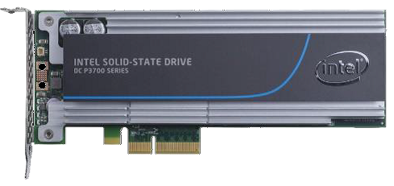
PCIe/NVMe SSD Storage Benefits
NVMe Protocol
Designed to Control SSD Storage
PCIe Bus
High Performance due to multiple ‘lanes’ or paths directly to Intel CPU
PCIe/NVMe
Fastest Connection possible for SSD Storage
Provides Fast, Low Latency Storage
Possibly moving system bottleneck to other subsystems, such as network access
Notes:
It is important to note that the PCIe bus address internal storage. Currently, all SSD disks attached using PCIe/NVMe must be internal to the server. This may be a limitation for data centers since their architecture is often based upon networked SAN style storage. This will change in the near future – more on this below in the document.
It is important to analyze customers high availability needs when recommending PCIe/NVMe SSD storage. Servers using PCIe/NVMe SSDs do not currently provide the hot swap features or hardware RAID capabilities.
The good news is that industry standards for both PCIe & NVMe have been expanded to provide these features. Look for future announcements from server OEMs.
This does not mean that there are no high availability options for PCI\e/NVMe SSD storage. Software RAID is available for via Intel Rapid Storage Technology Enterprise. In addition, it is common to use software to mirror data across systems to provide increased availability. In addition, advances in virtualization of the three major components of a server, compute, storage and network, make failure of an individual part manageable.
Another alternative is to use the approach many hyper-scale data centers use to provide continuous operations. In the event of a failure of any component of the server, workload shifts to another server.

Slide 24
Advantages of NVMe/PCIe over SAS for SSDs
Provides Best Bandwidth & Lowest Latency for SSDs
Second Only to DRAM in Performance & Latency
Designed and Optimized for SSDs Replacing Interface Designed for HDDs
Directly interfaces with Intel CPU Maximizing Performance
Less Power - Typically > 2W Idle and >9W Maximum
Eliminates HBA Overhead and Cost
Scalable Performance, Flexible Form Factors, and Industry Standard Stability
Notes:
NVMe/PCIe offers the best storage bandwidth and lowest latency for SSD storage, in part because the PCIe connection offers direct lanes to the server’s Intel CPU that allows for advanced data coordination.
In addition, since the NVMe protocol provides a number of additional advantages over SAS and SATA for SSDs

Slide 25
NVMe/PCIe Provides Flexible Form Factors
M.2
U.2 2.5in/SFF-8639
Add-in Card
42, 80 & 110mm Lengths - Smallest Footprint for PCIe, used for boot or max storage density
2.5in makes up majority of SSDs sold today, easy to deploy and service
Add-in-card (AIC) has maximum system compatibility, high power envelope, and options for height and length
Notes:
PCIe/NVMe SSD come in several different form factors, each with unique characterizes to meet variety of server needs.

Slide 26
Optimizing Performance with PCIe/NVMe SSD Storage
HDD storage has traditionally been a servers performance constraint
High Performance PCIe/NVMe Storage May Move the Constraint
CPU
Network Infrastructure
Need to Analyze Other Sever Components for New Constraints:
Would CPU Upgrade Provide Better Performance?
Would Performance Increase with Faster Network Infrastructure?
Notes:
A server’s storage subsystem has traditionally been the slowest component in a server. Replacing mechanical hard drives, and the logical device drivers that were designed for them, with PCIe/NVMe SSD storage provides the lowest latency and highest performance storage subsystem.
Removing the storage subsystem as a server’s bottleneck may also move the performance bottleneck to another component. Depending upon the workload, network speed or the CPU are logical components to analyze when looking for a new bottleneck.
Upgrading a data center’s fabric and servers to 100Gb Ethernet may achieve better overall server performance. In addition, upgrading the CPU to a faster processor or one with more cores may also increase workload performance.

Slide 27
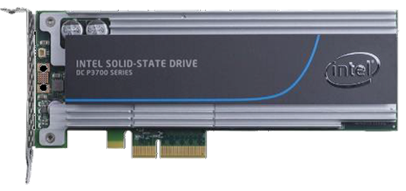
PCIe/NVMe SSD Storage Considerations
PCIe/NVMe SSD’s are Internal to the Server
If Data Center uses SAN Storage, Re-Architecture Necessary
Hot-Swap PCIe/NVMe SSDs Will Be Provided In the Future by OEMs
Software RAID is Available
Hardware RAID Currently Not Available
High Availability Option
Entire System Mirror vs Redundant Components
Notes:
It is important to note that the PCIe bus address internal storage.
Currently, all SSD disks attached using PCIe/NVMe must be internal to the server. This may be a limitation for data centers since their architecture is often based upon networked SAN style storage. This will change in the near future – more on this below in the document
It is important to analyze customers high availability needs when recommending PCIe/NVMe SSD storage.
Hot-Swap is supported by the PCIe/NVMe protocol, however OEM’s such as HPE and Lenovo have not yet delivered servers with this capability. Look for it in the near future
Servers using PCIe/NVMe SSDs do not currently provide the hot swap features or hardware RAID capabilities.
The good news is that industry standards for both PCIe & NVMe have been expanded to provide these features. Look for future announcements from server OEMs.
This does not mean that there are no high availability options for PCIe/NVMe SSD storage.
Software RAID is available for via Intel Rapid Storage Technology Enterprise.
In addition, it is common to use software to mirror data across systems to provide increased availability. In addition, advances in virtualization of the three major components of a server, compute, storage and network, make failure of an individual part manageable.
Another alternative is to use the approach many hyper-scale data centers use to provide continuous operations. In the event of a failure of any component of the server, workload shifts to another server.

Slide 28
Where PCIe/NVMe Storage Should be Recommended
Where Increased Responsiveness and Performance outweigh the Price Premium of PCIe/NVMe Storage
Ideal for any Data-heavy, Low-latency Content
Where Data is Local & Dedicated to the Server
Applications such as OLAP, OLTP, and Video
Not Recommended as a Boot Drive
Lower cost SATA SSDs are Adequate/Less Expensive
Notes:
PCIe/NVMe storage is the fastest, lowest latency access to data available to servers. Connecting storage using the PCIe bus and NVMe protocol eliminates the need for latency-adding adapters to attach storage.
This makes it ideal for any data-heavy, low-latency content when the increased responsiveness and performance can justify the premium PCIe/NVMe storage commands.
Applications that are data-heavy and benefit from low-latency include Online Transaction Processing (OLTP) and Online Analytical Processing (OLAP) applications.
In addition, customers looking to invest in in-memory solutions such as SAP HANA or IBM’s DB2 in memory database should also carefully evaluate PCIe/NVMe storage. A solution based on PCIe/NVMe storage may offer the performance boost needed, at a lower cost.

Slide 29
Perfect Fit - PCIe/NVMe SSDs as Cache or Tiered Storage
Caching - Active Data Copy Between Application and Storage
Provides Fast Storage Buffer between Application and Slower Storage
Can Incrementally Accelerate I/O for Applications
Automated Storage Tiering - Moves Data Based on Data Activity
“Hot”/Frequently Accessed Data
Moved to Fastest, Most Expensive Storage
Recommendation: PCIe/NVMe SSDs
“Warm”/Less Frequently Accessed Data
moved to Slower, Less Expensive Storage
Recommendation: SAS or SATA SSDs
“Cold”/Even Less Frequently Accessed Data
Moved to Slowest, Least Expensive Storage
Recommendation: HDDs
Notes:
PCIe/NVMe storage is commonly used to accelerate active I/O either by using it as a cache or as a tier of storage.
These are the most popular uses of PCIe/NVMe SSD storage since its introduction due to the higher cost associated with this newer technology. If a customer’s budget cannot accommodate an entire PCIe/NVMe SSD solution, a scaled back configuration using PCIe/NVMe SSDs as cache or tiered storage may accelerate performance at a reduced cost.
Caching keeps a copy of active data between the application and other, slower back-end storage.
Using PCIe/NVMe storage for cache incrementally increase overall application performance.
Automated storage tiering automatically places data on multiple types of media depending on the activity of the data.
The advantage to tiering is “hot” (frequently accessed) data can be stored on faster, more expensive media such as PCIe/NVMe SSDs.
“Warm’ (less frequently accessed) data can reside on less expensive SAS or SATA SSDs.
“Colder’ data, which is even less accessed less than ‘warm’ data, can be made up of low cost traditional hard disk drives or be located on a SAN or other externally attached storage.

Slide 30
Types of Applications to Target
Online Transaction Processing
Analytics
Content Delivery
Streaming Media, VOD
Database Query Acceleration
Gaming
Video Surveillance
Online Analytical Processing
HPC Applications
Business Intelligence
Batch Processing
Data Warehouse & Reporting
ERP Systems
High Transaction Processing
Massive Data Feeds & Reporting
Notes:
PCIe/NVMe storage is the fastest, lowest latency access to data available to servers. Connecting storage using the PCIe bus and NVMe protocol eliminates the need for latency-adding adapters to attach storage.
This makes it ideal for any data-heavy, low-latency content when the increased responsiveness and performance can justify the premium PCIe/NVMe storage commands.
Applications such application categories are Online Transaction Processing (OLTP) and Online Analytical Processing (OLAP) applications.
OLTP applications typically handle many short transitions in quick, random bursts, making these solutions well suited to the boost PCIe/NVMe SSDs can provide.
OLAP applications handle bigger chunks of data, typically received from multiple sources. These types of applications require quick responses to complex queries - making them prime candidates to benefit from the performance PCIe/NVMe storage offers.

Slide 31
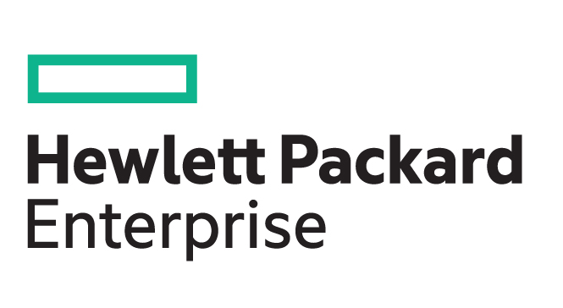
Server Support for PCIe/NVMe 2.5” Drives
HPE - Supported by HPE ProLiant DL360, DL380, DL580, and ML350 Gen 9 Servers
Lenovo - Supported by Lenovo System x, ThinkServer, and Flex System Servers
Check OEM Websites for Guidance and Updated Information
Notes:
HPE® ProLiant® servers support NVMe 2.5” SSDs. These drives are front accessible and serviceable, but require a PCIe Express Bay Enablement Kit.
HPE systems supported are the HPE ProLiant DL360, DL380, DL580, and ML350 Gen9 Servers.
Lenovo® provides NVMe/PCIe SSD support in the Lenovo System x®, ThinkServer®, and Flex System™ servers.

Slide 32
Intel PCIe/NVMe Product Lineups
Drive | Form factor | Capacity (GB) | Performance specs (up to) | Technologies
Intel® SSD DC P3520 Series | PCIe 3.0 x 4 U.2 2.5-inch, Low profile AIC* (HHHL**) | 450 / 1.2 TB / 2 TB | 375,000 IOPS / 1,700 MB/s | Intel 3D NAND, Enhanced Power Loss Data Protection, End-to-End Data Path Protection, Enterprise Reliability Features
Intel® SSD DC P3608 Series | HHPCIe 3.0 x 8 HHHL AICHL AIC | 1.6 TB / 3.2.TB / 4.0 TB | 850,000 / 150,000 | 20nm Intel NAND MLC Flash Memory with High Endurance Technology, Enhanced Power Loss Data Protection, End Data Path Protection, Dual NVMe Controller, Enterprise Reliability Features
Intel® SSD DC P3700 Series | PCIe 3.0 x 4 U.2 2.5-inch, Low profile AIC* (HHHL**) | 400 / 800 / 1.6 TB / 2.0 TB | 460,000 / 175,000 | 25nm Intel NAND MLC Flash Memory with High Endurance Technology, Enhanced Power Loss Data Protection, End-to-end Data Path Protection, Enterprise Reliability Features
Intel® SSD DC P3600 Series | PCIe 3.0 x 4 U.2 2.5-inch, Low profile AIC* (HHHL**) | 400 / 800 / 1.2 TB / 1.6 TB / 2.0 TB | 450,000 / 56,000 | 25nm Intel NAND MLC Flash Memory with High Endurance Technology, Enhanced Power Loss Data Protection, End-to-end Data Path Protection, Enterprise Reliability Features
Intel® SSD DC P3500 Series | PCIe 3.0 x 4 U.2 2.5-inch, Low profile AIC* (HHHL**) | 400 / 1.2 TB / 2.0 TB | 430,000 / 28,000 | 25nm Intel NAND MLC Flash Memory with High Endurance Technology, Enhanced Power Loss Data Protection, End-to-end Data Path Protection, Enterprise Reliability Features
*ACI = Add-in Card ** HHHL =half-height, half length
Notes:
Intel provides a powerful line of PCIe/NVMe SSDs for the data center.
Each product line is designed to provide the flexible form factors, performance and capacity needed in the data center. Here is a look at Intel’s current PCIe/NVMe product line:

Slide 33
Newly Announced - NVMe over Fabrics
Standards released 6/9/16
Expands NVMe Protocol Beyond PCIe to Ethernet, Fibre Channel, InfiniBand & Intel OmniPath
Allows NVMe to Attach Storage Outside the Server to attached SANs and External SSD Storage
First product announced Broadcom NVMe over Fibre Channel HBA
Look for OEM products in the next 6-9 months
Notes:
The new standards governing NVME over fabrics were released on June 9, 2016, allowing NVMe to expand beyond the internal-to-the-server PCIe bus to include fabrics such as Ethernet, Fibre Channel InfiniBand and Intel OmniPath
This is key because the low-latency and performance of NVMe SSDs will soon cater to the multi-host environments that are standard in most data centers.
NVMe over Ethernet is expected to be a major player in the market because Ethernet is the basis for Network Attached Storage (NAS) storage file sharing capabilities and iSCSI-based Storage Area Networks (SANs).
NVMe over Fibre Channel (FC-NVMe) is also expected to be a major player in the market. Fibre Channel was designed for storage from its inceptions. It ensures that all storage data arrives to its network destination without loss at extreme throughput and low latency, while operating at high utilization rates. It also continues to be the most widely used transport for enterprise storage with the Fibre Channel Industry Association estimating 46 million ports in current operation in data centers today.
InfiniBand provides an interconnect with high bandwidth and low latency. SSDs using NVMe over InfiniBand (IB-NVMe) may be a natural addition to those data centers that currently use InfiniBand.
NVMe over Intel Omni-Path Architecture (OPA-NVMe) will provide HPC workloads with cost-cost effective support of storage in HPC clusters and features such as adaptive routing, traffic flow optimization and packet integrity protection.
Broadcom® announced the first NVMe over fabric product on July 19, 2016 with the announcement of the first NVME over Fibre Channel (16/32 Gb) HBA solution. Look for OEM’s including HPE and Lenovo to adopt certified NVMe over fabric adapters in the near future.
While NVMe over Fabrics will allow NVMe storage to seamlessly integrate into the architecture of data centers, but it will also add some amount to storage latency. This means that the currently available PCIe/NVMe storage will likely remain the lowest latency storage SSD solution

Slide 34
Next Generation - Intel Technology Advances
Intel Optane 3D Xpoint Memory
Next Advance in SSD Technology
Will close the gap between DRAM performance
and SSD performance
Enables Very Dense Memory Arrays that Scale
with Moore’s Law
Latency times much lower than NAND
Leap forward in the same way NAND eclipsed hard disk storage
Look for product releases in 2017
Notes:
Intel Optane™ Technology is a premium non-volatile memory media that has the potential to change the face of computing with an unparalleled combination of speed, endurance, and density at a competitive price.
The new soon-to-be-released Intel® Optane™ memory and Intel® Optane™ SSDs based on 3D XPoint media, eliminates the need for transistors used in current NAND based products. Optane technology enables very dense memory arrays that scale with Moore’s law. Optane technology marks a monumental jump forward in the same way adopting NAND eclipsed hard disk storage. Latency times are much lower than NAND and remain low as throughput increases. Look for PCIe/NVMe products based on this technology in 2017.

Slide 35
NVMe/PCIe is the Fastest, Lowest Latency SSD Server Storage
Developed Specifically for SSD Storage
High Performance, Low Latency SSD Storage
When Compared to SATA and SAS
NVMe is More than 2x as Efficient
NVMe Uses about 50% less CPU Resources
Notes:
Enterprise storage has undergone a dramatic performance boost with SSD storage. SAS and SATA SSDs use old technology designed for spinning hard drives to connect to the server.
The NVMe industry standard, developed specifically for SSD storage, eliminates the inefficiencies of older technology and the PCIe bus interfaces directly with the CPU. This makes PCIe/NVMe SSD storage the fastest SSD storage possible for a server.
NVMe over fabrics and the emergence of Intel Optane 3D Xpoint memory will ensure the continued evolution of SSD storage in the data center, however PCIe/NVMe attached SSD storage will remain the best performing, lowest latency connection for SSD server storage. This makes adoption of PCIe/NVMe storage in the data center a great investment.

